Slide 1





Ziquejie Terraces highlighted in call for global cooperation on agriculture

Slide 2
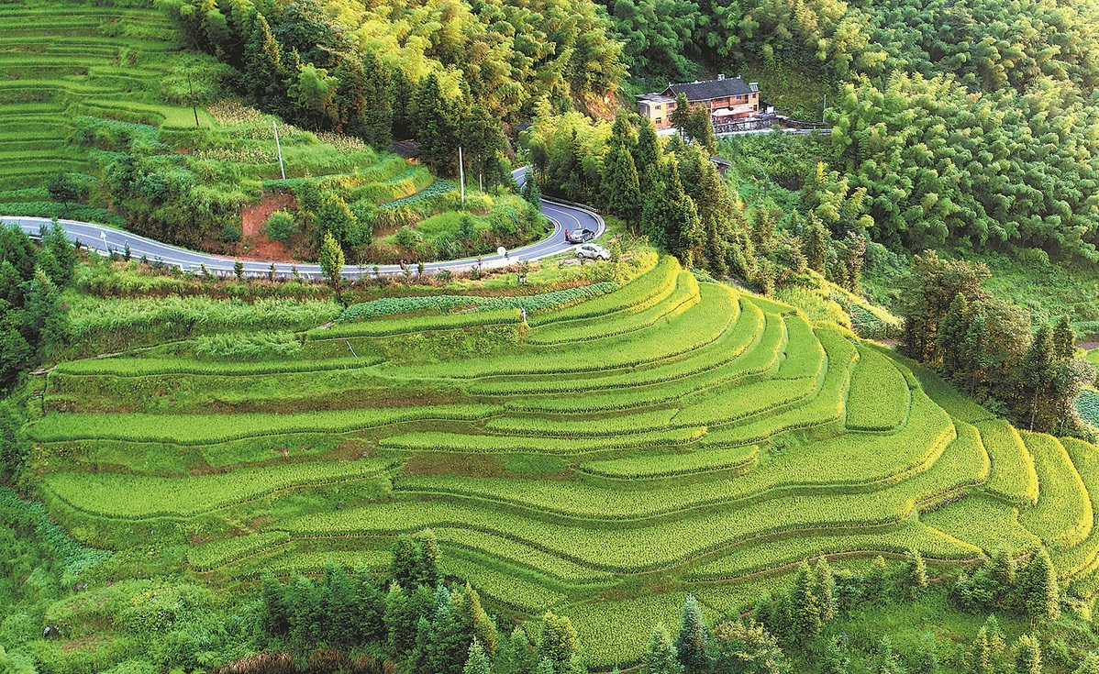
Information about Ziquejie Terraces
Ziquejie Terraces, found in Loudi, originated during the Qin (221-206 BC) and Han (206 BC-AD 220) dynasties.
The terraces have been recognized as a "Globally Important Agricultural Heritage System" by the United Nations Food and Agriculture Organization.
French sinologist David Gosset said Ziquejie Terraces are a magnificent symbol of Chinese ingenuity and dedication to sustainable agricultural practices.

Slide 3


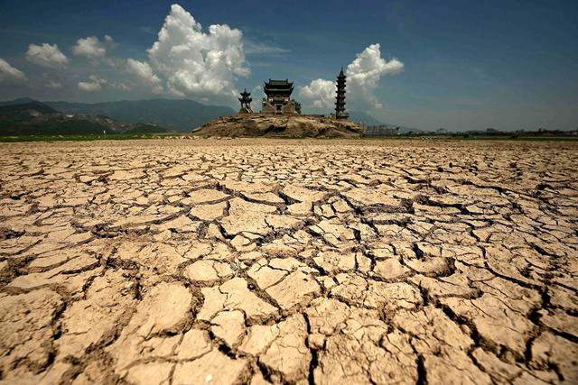
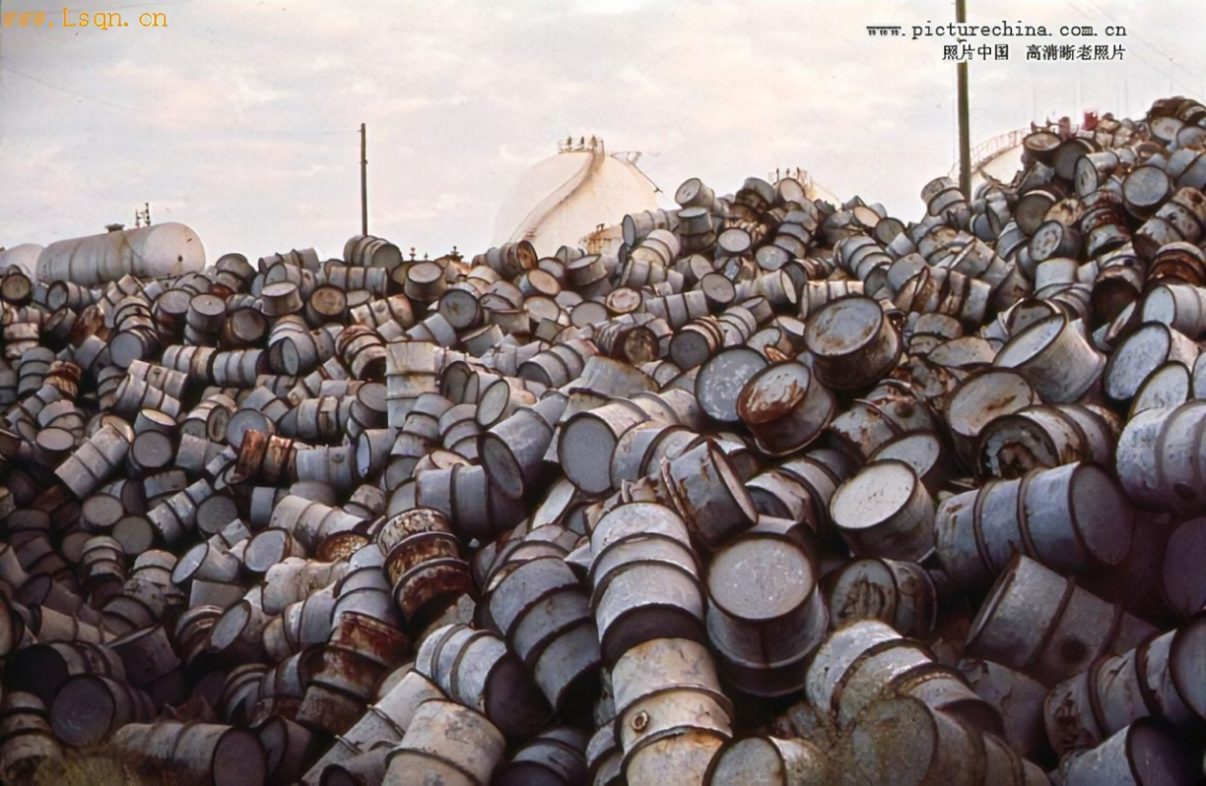
Compound Challenge
Climate Change
Ecological Degradation
a reduction in arable land and a loss of biodiversity
Environmental Crises

Slide 4


Pompeo Della Posta, a professor at the Belt and Road School of Beijing Normal University, said the massive challenges people are facing today — such as climate change, ecological degradation and environmental crises, together with the need to ensure food security, biodiversity protection or the sustainable use of water resources — can be faced successfully by sharing experiences and know-how developed in ecological governance, including efficient irrigation and drainage techniques in agriculture, as is the case with the Ziquejie Terraces.
However, Gosset is optimistic that people have viable solutions to address these pressing issues. "Advances in technology offer promising pathways to enhance agricultural productivity and sustainability. In today's context, urbanization is not necessarily at odds with farming. Urban farming(城市农业) and vertical farming(垂直农业) are becoming realities in many places, while hydroponics(水培法) — growing plants without soil — is also gaining momentum." he said.

Slide 5
Thank you for your listening

Slide 6

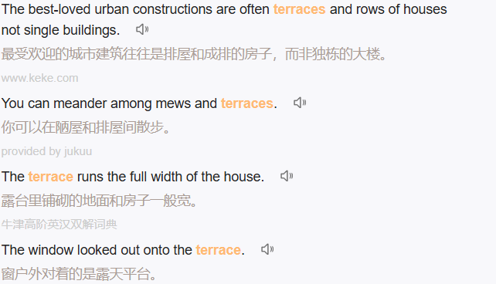
Terraces n.露台；梯田；阶地；台阶；台地

Slide 7






Slide 8



